Slide 1
Digital Portfolio
STUDENT NAME:RISHABA M
REGISTER NO AND NMID: 2428C0505 AND D1A1751D7009D8FB6B0483B38BC6EE0C
DEPARTMENT: Bsc AI&ML
COLLEGE: KPR College of Arts Science and Research

Slide 2
PROJECT TITLE
Business Owner Portfolio

Slide 3


AGENDA
Problem Statement
Project Overview
End Users
Tools and Technologies
Portfolio design and Layout
Features and Functionality
Results and Screenshots
Conclusion
Github Link
3/21/2024 Annual Review

Slide 4

PROBLEM STATEMENT
Business owners often lack a structured digital platform to showcase their brand, achievements, and services. Traditional profiles or resumes do not effectively reflect their entrepreneurial journey, making it harder to attract clients, investors, or partners. A well-organized portfolio is essential to highlight expertise, business value, and success stories

Slide 5

PROJECT OVERVIEW
Development of a Business Owner Portfolio Website.
Showcases brand identity, services, and achievements.
Provides a professional platform to attract clients and investors.
Highlights case studies, testimonials, and success stories.
Builds credibility, visibility, and networking opportunities.

Slide 6

WHO ARE THE END USERS?
Clients/Customers – explore services and offerings.
Investors/Partners – evaluate credibility and business potential.
General Audience – learn about the business journey.
Business Owner – enhance visibility and networking.

Slide 7

TOOLS AND TECHNIQUES
Frontend: HTML, CSS, JavaScript
Design Tools: Canva, Figma
Hosting: GitHub Pages / WordPress
Analytics: Google Analytics
Version Control: Git & GitHub

Slide 8
POTFOLIO DESIGN AND LAYOUT
Homepage: Introduction & business tagline.
About Section: Entrepreneur’s journey and expertise.
Services/Products Section: Business offerings.
Case Studies/Projects: Success stories and client work.
Testimonials: Feedback from clients and partners.
Contact Section: Email, LinkedIn, social media links.
8

Slide 9
FEATURES AND FUNCTIONALITY
Responsive and modern UI design.
Service highlights with icons and visuals.
Case study showcase with results.
Testimonials for credibility.
Contact form and social media integration.

Slide 10
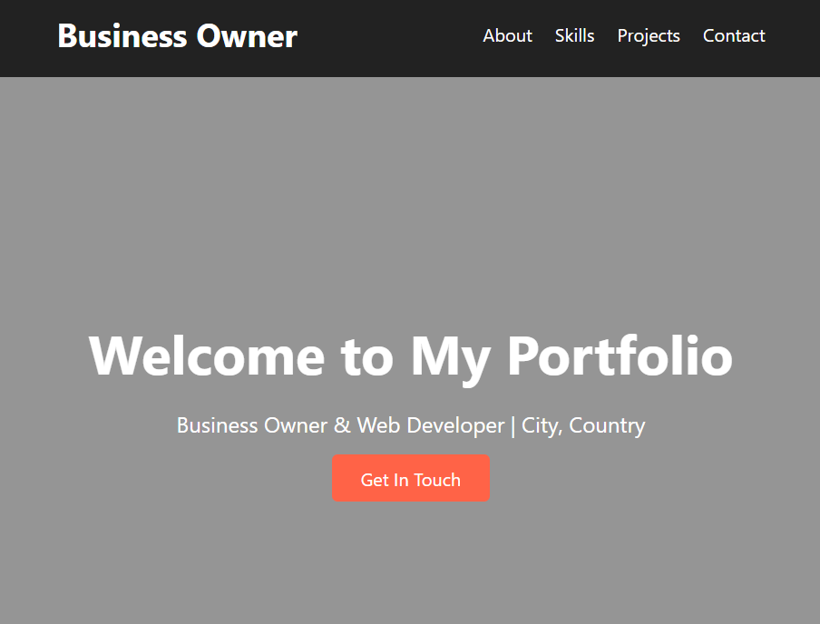

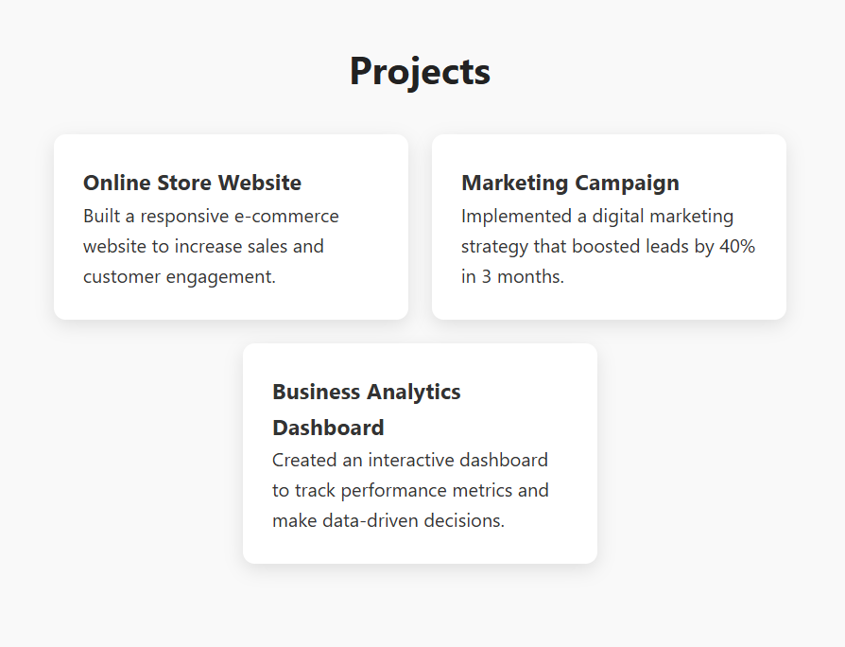
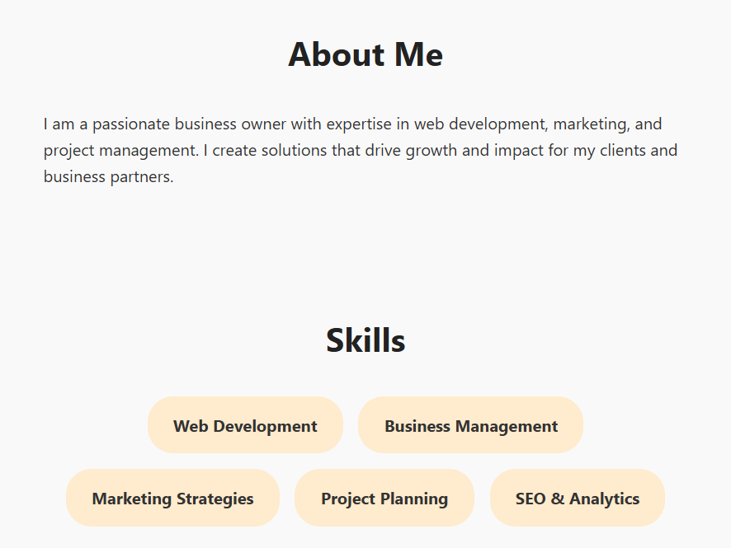
RESULTS AND SCREENSHOTS
Showcases business growth stories.
Highlights services with professional design.
Provides credibility through testimonials.
Engages audience with visuals and case studies.
3/21/2024 Annual Review
10

Slide 11
CONCLUSION
The portfolio establishes a strong digital presence for business owners, builds trust with potential clients and investors, and acts as a professional platform to expand business opportunities.
11

Slide 12
GITHUB LINK
Portfolio Repository :
https://github.com/rishaba2428/business-owner-portfolio.git

